Slide 1

Banking Database Management
Course: Database Management 1
Instructor: Prof. Dr. Melike ŞahDirekoğlu
Group Members:
Farhaneh Aryanejad
Amanuel Galema
Nathan Ngoyi
Joshua Omotosho

Slide 2
Introduction
Banking database management is essential for efficient handling of customer and transaction data in the system.
We have designed the database to efficiently manage essential operations and ensure data integrity.
It connects core entities such as accounts, customers, employees, branches, loans, and transactions.
The schema supports critical functionalities like account management, loan processing, transaction tracking, and card services.
We have organized the structure to ensure seamless collaboration between various banking operations, enhancing overall efficiency and customer satisfaction.

Slide 3
The Database Design and Implementation Steps
Step One
Step Two
Step Three
Database Schema Design
Drawing The ERD
Data Definition Language
Banking Management
Step Four
Step Five
Data Manipulation Language
Related Queries

Slide 4
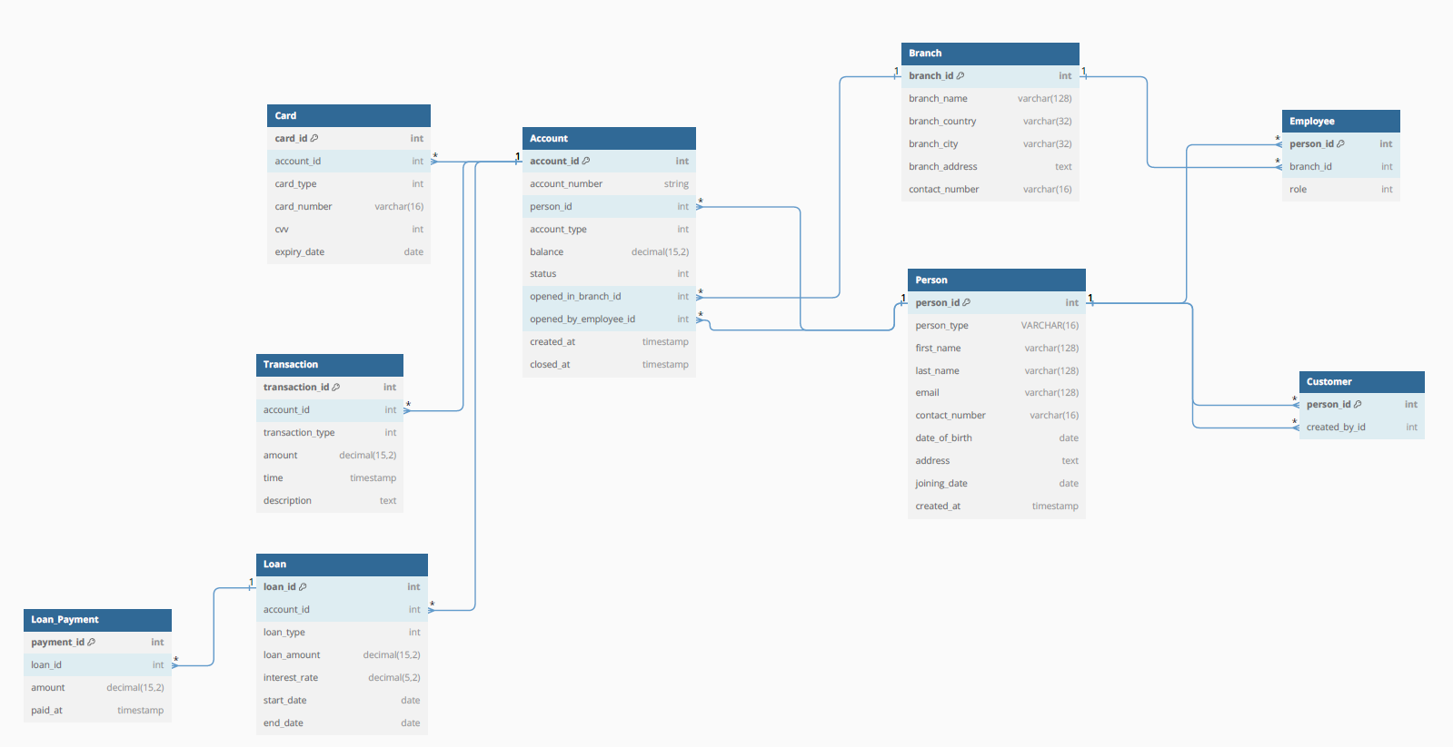
Step One : Database Schema Design

Slide 5
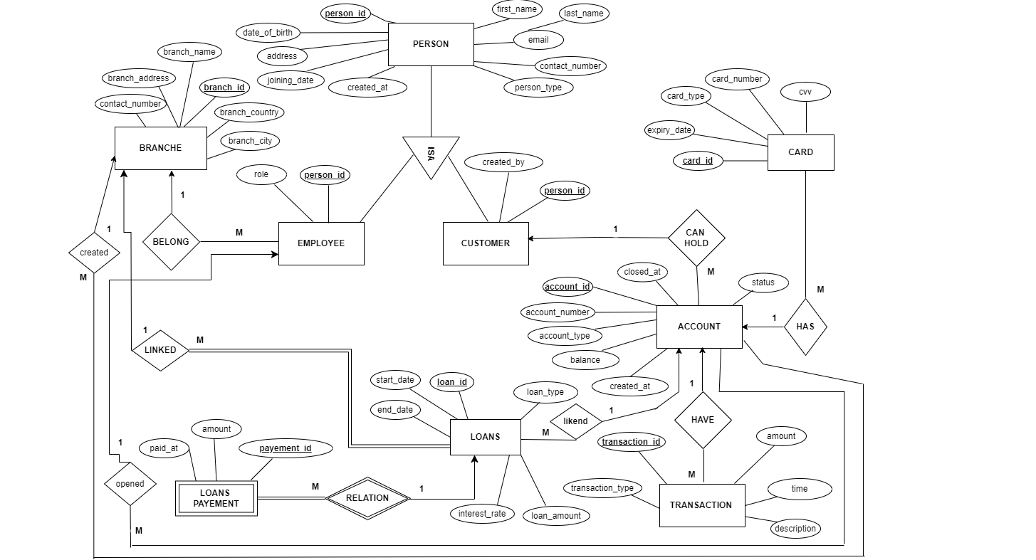
Step Two : ERD (Entity Relationship Diagram)

Slide 6
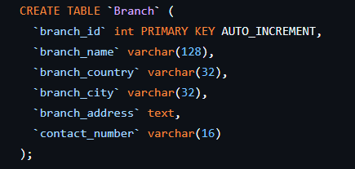
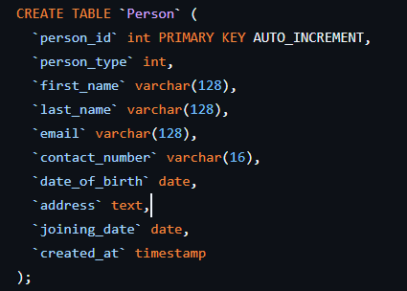
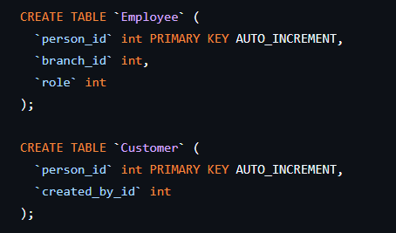
Step Three : Data Definition Language

Slide 7
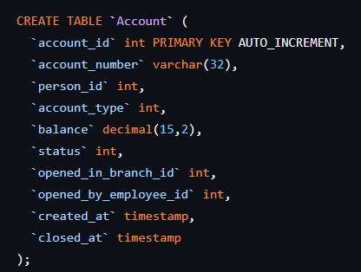
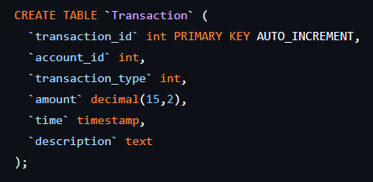
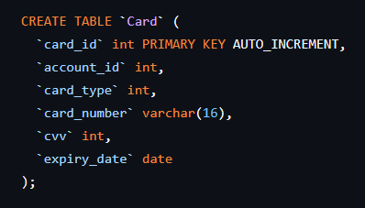
Step Three : Data Definition Language

Slide 8
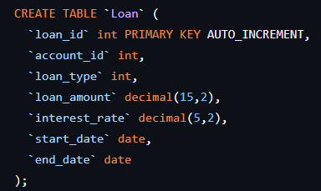
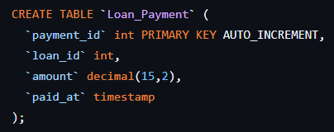
Step Three : Data Definition Language

Slide 9
Step Four : Data Manipulation Language
INSERT DATA FOR TABLE BRANCH
INSERT INTO "Branch" (branch_id, branch_name, branch_country, branch_city, branch_address, contact_number)
VALUES
(1, 'Central Branch', 'USA', 'New York', '100 Main Street', '+1-212-555-0101’),
(2, 'West Branch', 'USA', 'Los Angeles', '200 West Sunset Blvd', '+1-310-555-0102'),
(3, 'East Branch', 'USA', 'Boston', '300 Commonwealth Ave', '+1-617-555-0103'),
(4, 'North Branch', 'Canada', 'Toronto', '400 Maple Street', '+1-416-555-0104'),
(5, 'South Branch', 'USA', 'Miami', '500 Ocean Drive', '+1-305-555-0105'),
(6, 'London Branch', 'UK', 'London', '600 High Street', '+44-20-555-0106'),
(7, 'Paris Branch', 'France', 'Paris', '700 Rue de Rivoli', '+33-1-555-0107'),
(8, 'Berlin Branch', 'Germany', 'Berlin', '800 Unter den Linden', '+49-30-555-0108'),
(9, 'Tokyo Branch', 'Japan', 'Tokyo', '900 Shibuya Crossing', '+81-3-555-0109'),
(10, 'Sydney Branch', 'Australia', 'Sydney', '1000 George Street', '+61-2-555-0110');
INSERT DATA FOR TABLE ACCOUNT
INSERT INTO "Account" (account_number, person_id, account_type, balance, status, opened_in_branch_id, opened_by_employee_id, created_at, closed_at)
VALUES
('ACC-1001', 10001, 1, 1000.20, 1, 1, 10005, '2018-12-31', NULL),
('ACC-1002', 10009, 2, 2500.50, 1, 9, 10507, '2020-10-07', NULL),
('ACC-1003', 10011, 1, 501.00, 1, 3, 10015, '2019-05-10', NULL),
('ACC-1004', 10027, 2, 10000.00, 1, 4, 10036, '2021-11-02', NULL),
('ACC-1005', 10028, 2, 750.75, 1, 7, 10237, '2024-06-17', NULL),
('ACC-1006', 10051, 1, 220.00, 1, 6, 10171, '2023-02-24', NULL),
('ACC-1007', 10101, 2, 3000.00, 1, 5, 10109, '2022-09-30', NULL),
('ACC-1008', 10189, 1, 400.00, 1, 8, 10251, '2020-08-28', NULL),
('ACC-1009', 10194, 2, 9900.99, 1, 2, 10008, '2023-01-13', NULL),
('ACC-1010', 10266, 1, 50.00, 1, 10, 10532, '2018-04-16', NULL);

Slide 10
Step Four : Data Manipulation Language
INSERT DATA FOR TABLE PERSON
INSERT INTO "Person" (person_ID, first_name, last_name, email, contact_number, date_of_birth, address, person_type, joining_date, created_at)
VALUES
(10001, 'John', 'Peters', 'john.peters@bankexample.com', '+1-212-555-1001', '1979-04-15', '101 Park Ave, New York, USA', 'Customer', '2008-03-15', NOW()),
(10005, 'Jane', 'Smith', 'jane.smith@bankexample.com', '+1-310-555-1002', '1982-08-21', '202 West Blvd, Los Angeles, USA', 'Employee', '2009-07-10', NOW()),
(10008, 'Robert', 'Johnson', 'robert.johnson@bankexample.com', '+1-617-555-1003', '1975-11-30', '303 Beacon St, Boston, USA', 'Employee', '2007-05-25', NOW()),
(10009, 'Emily', 'Davis', 'emily.davis@bankexample.com', '+1-416-555-1004', '1985-01-05', '404 Maple Rd, Toronto, Canada', 'Customer', '2010-02-14', NOW()),
(10011, 'Michael', 'Wilson', 'michael.wilson@bankexample.com', '+1-305-555-1005', '1978-06-11', '505 Ocean Dr, Miami, USA', 'Customer', '2006-11-01', NOW()),
(10015, 'Karen', 'Brown', 'karen.brown@bankexample.com', '+44-20-555-1006', '1980-09-12', '606 Regent St, London, UK', 'Employee', '2011-09-10', NOW()),
(10027, 'David', 'Jones', 'david.jones@bankexample.com', '+33-1-555-1007', '1977-12-02', '707 Rue Cler, Paris, France', 'Customer', '2005-04-30', NOW()),

Slide 11
Step Four : Data Manipulation Language
(10028, 'Linda', 'Garcia', 'linda.garcia@bankexample.com', '+49-30-555-1008', '1983-03-19', '808 Alexanderplatz, Berlin, Germany', 'customer', '2012-12-12', NOW()),
(10036, 'Mark', 'Miller', 'mark.miller@bankexample.com', '+81-3-555-1009', '1976-10-27', '909 Shinjuku, Tokyo, Japan', 'Employee', '2008-08-08', NOW()),
(10051, 'Patricia', 'Taylor', 'patricia.taylor@bankexample.com', '+61-2-555-1010', '1981-07-16', '1010 Darling St, Sydney, Australia', 'Customer', '2009-04-04', NOW()),
(10101, 'Alice', 'Anderson', 'alice.anderson@example.com', '+1-212-555-2001', '1990-03-14', '1101 Broadway, New York, USA', 'Customer', '2020-01-10', NOW()),
(10109, 'Peter', 'Thomas', 'peter.thomas@example.com', '+1-310-555-2002', '1992-05-29', '1202 Vine St, Los Angeles, USA', 'Employee', '2020-02-15', NOW()),
(10171, 'Susan', 'Jackson', 'susan.jackson@example.com', '+1-617-555-2003', '1988-11-03', '1303 Commonwealth Ave, Boston, USA', 'Employee', '2020-03-20', NOW()),
(10189, 'Daniel', 'White', 'daniel.white@example.com', '+1-416-555-2004', '1991-09-07', '1404 King St, Toronto, Canada', 'Customer', '2020-04-25', NOW()),
(10194, 'Sarah', 'Harris', 'sarah.harris@example.com', '+1-305-555-2005', '1989-01-12', '1505 Collins Ave, Miami, USA', 'Customer', '2020-05-30', NOW()),
(10237, 'Jessica', 'Martin', 'jessica.martin@example.com', '+44-20-555-2006', '1993-07-08', '1606 Baker St, London, UK', 'Employee', '2020-06-05', NOW()),

Slide 12
Step Four : Data Manipulation Language
(10251, 'Thomas', 'Thompson', 'thomas.thompson@example.com', '+33-1-555-2007', '1994-12-19', '1707 Montparnasse, Paris, France', 'Employee', '2020-07-10', NOW()),
(10266, 'Maria', 'Moore', 'maria.moore@example.com', '+49-30-555-2008', '1996-04-01', '1808 Potsdamer Platz, Berlin, Germany', 'Customer', '2020-08-15', NOW()),
(10507, 'James', 'Clark', 'james.clark@example.com', '+81-3-555-2009', '1995-02-23', '1909 Ginza, Tokyo, Japan', 'Employee', '2020-09-20', NOW()),
(10532, 'Laura', 'Lee', 'laura.lee@example.com', '+61-2-555-2010', '1993-06-14', '2010 Circular Quay, Sydney, Australia', 'Employee', '2020-10-10', NOW());

Slide 13
Step Four : Data Manipulation Language
ATTRIBUTE PERSON_TYPE CHANGE FROM INTEGER TO VARCHAR
ALTER TABLE "Person"
ALTER COLUMN person_type
SET DATA TYPE VARCHAR(16);
ENSURE NO DUPLICATE EMAIL IN THE PERSON TABLE
ALTER TABLE "Person"
ADD CONSTRAINT unqiue_email UNIQUE(email);
ENSURE NO DUPLICATE CONTACT_NUMBER IN THE PERSON TABLE
ALTER TABLE "Person"
ADD CONSTRAINT unqiue_contact UNIQUE(contact_number);

Slide 14
Step Four : Data Manipulation Language
INSERT DATA FOR TABLE EMPLOYEE
INSERT INTO "Employee" (person_id, branch_id, role)
VALUES
(10005, 1, 01),
(10008, 2, 02),
(10015, 3, 01),
(10036, 1, 02),
(10109, 5, 01),
(10171, 6, 01),
(10237, 1, 02),
(10251, 8, 01),
(10507, 9, 02),
(10532, 10, 01);
INSERT DATA FOR TABLE CUSTOMER
INSERT INTO "Customer" (person_id, created_by_id)
VALUES
(10001, 10532),
(10009, 10532),
(10011, 10532),
(10027, 10109),
(10028, 10251),
(10051, 10532),
(10101, 10532),
(10189, 10507),
(10194, 10015),
(10266, 10036);

Slide 15
Step Four : Data Manipulation Language
INSERT DATA FOR TABLE CARD
INSERT INTO "Card" (account_id, card_type, card_number, cvv, expiry_date)
VALUES
('1', 1, '4111111111111111', 123, '2025-12-31'),
('2', 1, '5500000000000004', 456, '2025-11-30'),
('3', 2, '4111111111111112', 234, '2026-10-31'),
('4', 2, '5500000000000005', 567, '2025-09-30'),
('5', 1, '4111111111111113', 345, '2026-08-31'),
('6', 1, '4111111111111114', 678, '2025-07-31'),
('7', 2, '5500000000000006', 789, '2026-06-30'),
('8', 1, '4111111111111115', 890, '2025-05-31'),
('9', 2, '5500000000000007', 901, '2026-04-30'),
('10', 1, '4111111111111116', 321, '2026-03-31');
INSERT DATA FOR TABLE TRANSACTION
INSERT INTO "Transaction" (account_id, transaction_type, amount, time, description)
VALUES
('8', 1, 100.00, ('2024-02-21 09:10:05'), 'Initial Deposit'),
('7', 2, 50.00, ('2022-07-18 12:22:41'), 'ATM Withdrawal'),
('1', 1, 500.00, ('2024-12-31 11:56:26'), 'ACH Deposit'),
('9', 1, 200.00, ('2023-10-27 08:15:03'), 'Check Deposit'),
('3', 2, 100.00, ('2024-05-10 07:27:15'), 'Online Purchase'),
('2', 1, 300.00, ('2021-12-12 10:48:00'), 'Cash Deposit'),
('4', 2, 150.00, ('2022-08-14 11:07:52'), 'Bill Payment'),
('5', 3, 1000.00, ('2024-09-09 00:12:38'), 'Wire Transfer In'),
('10', 2, 200.00, ('2020-11-01 12:55:11'), 'Debit Card Purchase'),
('6',1, 400.00, ('2023-12-07 10:31:22'), 'Mobile Deposit');

Slide 16
Step Four : Data Manipulation Language
INSERT DATA FOR TABLE LOAN
INSERT INTO "Loan" (account_id, loan_id, loan_type, loan_amount, interest_rate, start_date, end_date)
VALUES
('2', 0290, 1, 5000.00, 5.00, '2024-01-30', '2026-01-29'),
('7', 1059, 1, 10000.00, 4.50, '2024-02-19', '2027-02-18'),
('4', 0001, 2, 250000.00, 3.25, '2024-03-09', '2030-03-08'),
('6', 2832, 1, 2000.00, 6.00, '2024-04-15', '2025-04-14'),
('1', 2010, 2, 150000.00, 3.50, '2024-05-08', '2028-05-07'),
('3', 4372, 1, 7500.00, 5.25, '2024-06-20', '2027-06-19'),
('10', 3904, 2, 300000.00, 3.00, '2024-07-16', '2029-07-15'),
('5', 8392, 1, 4000.00, 5.75, '2024-08-31', '2026-08-01'),
('8', 2013, 1, 12000.00, 4.75, '2024-09-18', '2026-09-17'),
('9', 2387, 2, 200000.00, 3.20, '2024-10-11', '2031-10-10');
INSERT DATA FOR TABLE LOAN_PAYMENT
INSERT INTO "Loan_Payment" (payment_id, amount, paid_at)
VALUES
(0290, 500.00, '2024-04-29'),
(2832, 600.00, '2024-06-14'),
(2387, 2000.00, '2024-11-10'),
(1059, 250.00, '2025-12-18'),
(2010, 1500.00, '2027-12-07'),
(8392, 750.00, '2026-10-01'),
(0001, 30000.00, '2028-05-08'),
(3904, 400.00, '2029-02-15'),
(2013, 1200.00, '2025-03-17'),
(4372,2000.00, '2025-01-19');

Slide 17
Data migration process infographics
Venus
Mercury
Venus has a beautiful name and is the second planet from the Sun. It’s terribly hot, even hotter than Mercury
It’s the closest planet to the Sun and the smallest one in the Solar System—it’s only a bit larger than the Moon

Slide 18
Data migration process infographics
Jupiter
Neptune
Jupiter is a gas giant and the biggest planet in the Solar System
Neptune is the farthest planet from the Sun. It’s really cold there
Saturn
Mercury
Saturn is a gas giant with rings. It’s composed of hydrogen and helium
Mercury is the closest planet to the Sun and the smallest one

Slide 19
Data migration process infographics
Mars
Despite being red, Mars is a cold place. The planet is full of iron oxide dust
Saturn
Saturn is the ringed planet. It’s a gas giant, composed mostly of hydrogen
Neptune
Neptune is the farthest planet from the Sun. It’s really cold there
Mercury
Mercury is the closest planet to the Sun and the smallest one

Slide 20
Data migration process infographics
Neptune
Jupiter
Neptune is the farthest planet from the Sun
It’s the biggest planet in the Solar System
Venus
Saturn
It’s terribly hot, even hotter than Mercury
Saturn is the ringed planet and a gas giant
Mercury
Mars
Mercury is the closest planet to the Sun
Despite being red, Mars is a cold place

Slide 21
Data migration process infographics
Neptune
Jupiter
Mars
Neptune is the farthest planet from the Sun
Jupiter is the biggest planet in the Solar System
Despite being red, Mars is a cold place, not hot
Mercury

Slide 22
Data migration process infographics
Neptune
Jupiter
Neptune is the farthest planet from the Sun
It’s the biggest planet in the Solar System
Venus
Saturn
It’s terribly hot, even hotter than Mercury
Saturn is the ringed planet and a gas giant
Mercury
Mars
Mercury is the closest planet to the Sun
Despite being red, Mars is a cold place
The Sun
The Moon
It’s the star at the center of the Solar System
The Moon is Earth’s only natural satellite

Slide 23
Data migration process infographics
Mercury
Mercury is the closest planet to the Sun
Neptune
Neptune is the farthest planet from the Sun
Venus
Jupiter
It’s terribly hot, even hotter than Mercury
It’s the biggest planet in the Solar System
Saturn
Saturn is the ringed planet and a gas giant

Slide 24
Data migration process infographics
01
03
Jupiter
Saturn
Jupiter is a gas giant and the biggest planet in the Solar System
Saturn has several rings. It’s composed of hydrogen and helium
02
04
Mars
Venus
Despite being red, Mars is actually a very cold place
Venus has a beautiful name and is the second planet from the Sun

Slide 25
Data migration process infographics
35%
30%
Neptune
Saturn
Neptune is the farthest planet from the Sun. It’s really cold there
Saturn is the ringed planet. It’s a gas giant, composed of hydrogen and helium
23%
12%
Jupiter
Venus
Jupiter is a gas giant and the biggest planet in the entire Solar System
Venus has a beautiful name and is the second planet from the Sun

Slide 26
Data migration process infographics
1
7
8
8
Neptune
1
Jupiter
Neptune is the farthest planet from the Sun
It’s the biggest planet in the Solar System
2
6
7
3
5
Venus
4
Saturn
It’s terribly hot, even hotter than Mercury
Saturn is a gas giant with several rings
2
3
4
5
6
Mercury
Ceres
Mars
Earth
Mercury is the closest planet to the Sun
Ceres is located in the main asteroid belt
Despite being red, Mars is a cold place
Earth is the beautiful planet where we all live

Slide 27
Data migration process infographics
Introduction of an additional system
Shift to a centralized base
Ceres is located in the main asteroid belt
Despite being red, Mars is a cold place
Storage capacity expansion
Moving data to the cloud
Mercury is the closest planet to the Sun
Neptune is the farthest planet from the Sun
Legacy system modernization
Mergers and acquisitions
Venus is the second planet from the Sun
Saturn is the ringed planet and a gas giant
Historical data
Jupiter is the biggest planet of them all

Slide 28
Data migration process infographics
Storage migration: between physical media
Data center migration: between location/servers
Database migration: between DBMSs
Business process migration: Between infrastructures
Application migration: between platforms
Cloud migration: from on-prem/cloud to cloud

Slide 29
Data migration process infographics
Neptune
Jupiter
Neptune is the farthest planet from the Sun
25%
40%
It’s the biggest planet in the Solar System
Venus
Saturn
It’s terribly hot, even hotter than Mercury
70%
85%
Saturn is the ringed planet and a gas giant

Slide 30
Data migration process infographics
Data
From
To
Data volume
Mars | Admin system 1 | Cloud service 1 | 1.8 GB
Mercury | Admin system 2 | Cloud service 2 | 25.4 GB
Jupiter | Admin system 3 | Cloud service 3 | 12.8 GB
Saturn | Admin system 4 | Cloud service 4 | 59,.1 GB
Venus | Admin system 5 | Cloud service 5 | 2.9 GB

Slide 31
Data migration process infographics
Jupiter
Neptune
Jupiter is a gas giant and the biggest planet in the Solar System
Neptune is the farthest planet from the Sun. It’s really cold there
Saturn
Mercury
Saturn is a gas giant with ring. It’s composed of hydrogen and helium
Mercury is the closest planet to the Sun and the smallest one

Slide 32
Data migration process infographics
Neptune
Saturn
Neptune is the farthest planet from the Sun. It’s really cold there
Saturn is the ringed planet. It’s a gas giant, composed of hydrogen and helium
01
02
03
04
Jupiter
Venus
Jupiter is a gas giant and the biggest planet in the entire Solar System
Venus has a beautiful name and is the second planet from the Sun

Slide 33
Data migration process infographics
Process
Description
Risk
Phase 1 | Despite being red, Mars is a cold place
Phase 2 | Mercury is the closest planet to the Sun
Phase 3 | Neptune is the farthest planet from the Sun
Phase 4 | Saturn is the ringed planet and a gas giant
Phase 5 | Venus is terribly hot, even hotter than Mercury

Slide 34
Data migration process infographics
35%
55%
80%
Neptune
Mercury
Jupiter
Neptune is the farthest planet from the Sun. It’s really cold there
Mercury is the closest planet to the Sun and the smallest one
Jupiter is a gas giant and the biggest planet in the Solar System

Slide 35
Data migration process infographics
Neptune
Neptune is the farthest planet from the Sun
Jupiter
Mars
Jupiter is the biggest planet in the Solar System
Despite being red, Mars is a cold place, not hot
Venus
Venus is terribly hot, even hotter than Mercury

Slide 36
Data migration process infographics
Neptune
Jupiter
Neptune is the farthest planet from the Sun
It’s the biggest planet in the Solar System
Venus
Saturn
It’s terribly hot, even hotter than Mercury
Saturn is the ringed planet and a gas giant
Mercury
Mars
Mercury is the closest planet to the Sun
Despite being red, Mars is a cold place

Slide 37
Data migration process infographics
Jupiter
Saturn
Mercury
Venus
60%
19%
12%
9%
Jupiter is a gas giant and the biggest planet in the Solar System
It’s the ringed planet. It’s a gas giant, composed mostly of hydrogen
It’s the closest planet to the Sun and the smallest one of them all
Venus has a beautiful name and is the second planet from the Sun

Slide 38
Thank You For Your Attention.

